Slide 1

SWIFT Collateral Management Solutions
How bi-lateral and tri-party messages can mitigate counterparty and credit risk

Slide 2
Industry overview
Heightened risk awareness, demand for operational excellency
Increased focus on collateralisation
Push for standardisation and automation, cost consciousness
Change in regulatory landscape: strong voice of regulators
Different models for different markets and needs
Bilateral model
Triparty model
Next….?
Bilateral Collateral Management
CCP Clearing
Triparty Collateral Management

Slide 3
Collateral Management = Risk free?
NO. Collateral Management does NOT eliminate the Counterparty Risk
In fact, it transfers the risk into
  Operational Risk
!
  Settlement Risk
  Market Risk
  Liquidity Risk

Slide 4
Components of Collateral Management?
Selection of Collateral
Valuation of Collateral (mark to market)
Margin calls
Settlement
Substitution
Optimization
Custody administration (coupon, redemption,…)
Custody administration (coupon, redemption,…)

Slide 5
How to manage collateral?
Bilateral Collateral Management
In-house Collateral Management integrated in
back-offices
Direct contact with counterparties
Triparty Collateral Management
Usage of a neutral agent to perform Collateral Management functions
Outsourcing
Reduce Operational, Settlement, Market and Liquidity risks

Slide 6








SWIFT offering in Collateral Management space
Bilateral Collateral Messages
Solution scope extension and replacement
of existing FIN messages with MXs
New Solution!
Triparty Collateral Messages
Established suite of FIN messages for E2E processing
Triparty Agent

Slide 7
How to manage collateral?
 | Bilateral | Triparty
Selection of Collateral | Manual or Automated Simple eligibility criteria | Automatic selection Sophisticated eligibility criteria
Mark to Market | Daily, Weekly, or even Monthly | Daily and Automated
Margin calls | Once a day, Weekly or even Monthly | Fully Automated
Settlement | Required follow up | Automated
Substitution | Once a day and “Get before you Give” | Unlimited and DVP (Delivery Versus Payment)
Optimization | Limited | Automated across all asset types
Custody administration (coupon, redemption, …) | Manual compensation | Automatic compensation

Slide 8
Bilateral Collateral Management messages
PowerPoint Toolkit – 23 October 2008 – Confidentiality: restricted

Slide 9
Drivers for development alongside regulatory landscape
Sept 2008: SWIFT, ISITC, FIX protocol and ISDA / FpML set up Investment Roadmap, agree to provide consistent direction and alignment on messaging developments for the industry
Oct 2009: SWIFT advises ISDA under the Investment Roadmap, there were ISO 20022 developments underway that would benefit from ISDA and SWIFT cooperating on OTC Derivatives / Collateral Management
November 2009: ISDA Collateral Committee publish proposal for standardization supporting the business flows between Collateral Taker/Collateral Giver
February 2010: A joint business justification submitted by SWIFT, FIX and ISDA with ISITC sponsorship to the ISO 20022 Registration Management Group. Approved by the RMG in April 2010
September 2010: Completion of message development

Slide 10





How are we trying to help our customers?
Data capture and margin call calculation (in-house flows)
Agree and process calls
Issuance of a margin call
Negotiation of margin call
(Dis)Agreement of collateral
Dispute notification
Reporting
Booking and settlement of collateral
New SWIFT Messaging Solution replacing e-mail & fax
Substitution
Interest processing

Slide 11
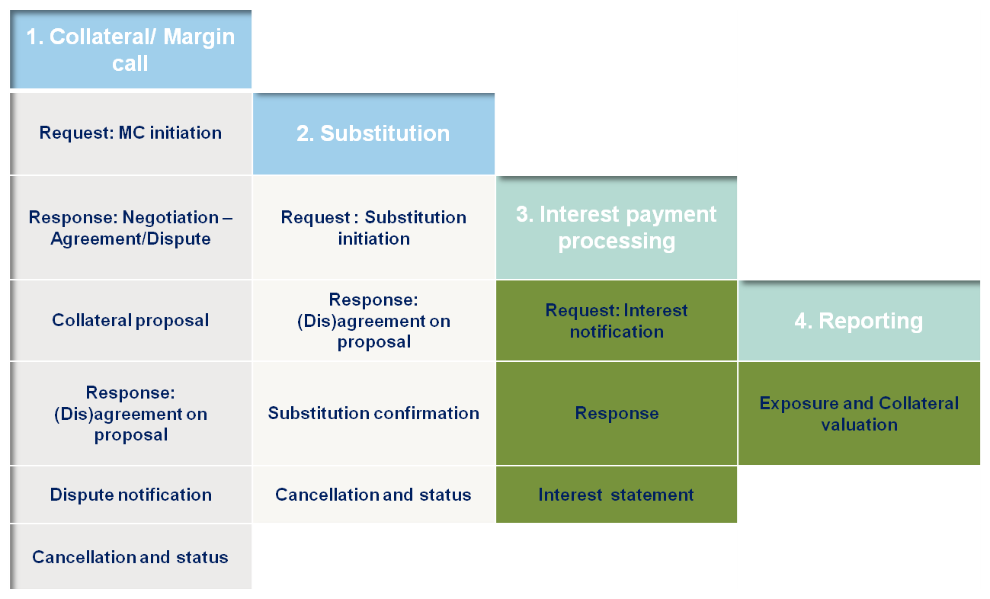
SWIFT bilateral collateral message flows
Cross asset coverage: Equities, Fixed income, Listed derivatives, FX, Commodities, Cash, OTC derivatives
Phase 2
Phase 1

Slide 12

SWIFT bilateral collateral message delivery
March 2011
6 November 2010 |  | Vendor Test System
4 December 2010 |  | Pilot System
5 March 2011 |  | Collateral Management – Margin call & Substitution -Go-Live
May 2011
22 January 2011 |  | Vendor Test System
26 February 2011 |  | Pilot System
21 May 2011 |  | Collateral Management – Interest payment & Reporting Go – Live

Slide 13
Value creation: Bilateral collateral messages
Risk
Operations
Industry
Elimination of manual processing
Increased transparency
Maximise asset management cross departments
Enhanced operational control through automation and standardisation
Scalability
Ability to focus on exception management
Flexibility to expand other margining models (ie CCP)
Compliance with Industry Best Practices and regulatory requirements
SWIFT also provides reach to a wider community over secure network with guaranteed message delivery

Slide 14
Triparty Collateral Management messages

Slide 15
Triparty Collateral Management offering
Straight-through processing connectivity
Matching of exposures
Selection of Collateral fully automated
Real time automatic allocation of collateral for new exposure
Automatic allocation (AutoAssign)-every 15 min
Unlimited and automatic substitution(DVP)-every 15 min
Optimization of collateral-every 15 min
Custody administration (coupon, redemption,…)

Slide 16
Triparty Collateral Management - Clearstream One single umbrella
Collateral Management eXchange (CmaX)
Central banks
(tenders & discount windows)
Repos
CCPs
Securities
lending
GC Basket
Trading
(Euro GC Pooling)
Collateral Management
(derivatives,structured financing, loans, etc)
Collateral receiver
Central banks
Commercial banks
Private banks
Supranationals
State agencies
Asset managers
Collateral giver
Brokers dealers
Commercial banks
Asset managers
Investment banks
Bilateral exposure
Clearstream as triparty collateral agent
Re-use, auto allocation, margin calls, auto substitutions, eligibility checks, mark-to-market, reporting

Slide 17

Clearstream focus in collateral management products developments
STP (straight through processing)
Transparency
Standardisation
New asset classes
New distribution channels
Partnerships
!

Slide 18

Clearstream focus in collateral management developments
STP (straight through processing)
Transparency
Standardisation
New asset classes
New distribution channels
Partnerships
!

Slide 19
Trends of the market - need for STP solutions
Global Securities Financing Totals, Weekly Average
850
800
750
USD 756 bn
per October 2009
Euro 518 bn
700
650
600
550
500
bn
450
400
350
300
250
200
150
100
50
0
Jul-03
Nov-03
Mar-04
Jul-04
Nov-04
Mar-05
Jul-05
Nov-05
Mar-06
Jul-06
Nov-06
Mar-07
Jul-07
Nov-07
Mar-08
Jul-08
Nov-08
Mar-09
Jul-09
Nov-09
Mar-10
Jul-10
GSF € Total
BUBA and EGCP €
TRI-REPO & TSLS €
GSF $ Total

Slide 20

Life-cycle of a Triparty transaction:
From matching to settlement
Matching of exposure
Allocation
Eligibility
Substitutions
Mark-to-Market
Margin Calls
Re-use
Reporting
Collateral Giver
Collateral Receiver
Exposure Notification (MT527)
Exposure Notification (MT527)
Matching Status (MT558)
Matching Status (MT558)
Collateralisation Status (MT558)
Collateralisation Status (MT558)
Collateral and Exposure Statement
(MT569)
Collateral and Exposure Statement
(MT569)

Slide 21



Case study: Triparty for central banks
1
BCL domestic counterparty
5
2
3
4
4
Domestic counterparty advises BCL via an MT527 of the amount of collateral to be pledged via TCMS
Following an internal validation process, BCL communicates the requested collateral amount to CBL as Collateral Receiver and
On behalf of the Collateral Giver using an MT527 i.e. 2 SWIFT messages are sent to CBL
CBL confirms the collateralisation status to BCL (MT558) and to the counterparty if required (MT558, CreationOnline, CreationDirect )
BCL updates the credit line accordingly

Slide 22
Industry standard to STP solution
Coverage of full transaction cycle with market Standards
Increased transparency towards Customers
Increased downstream STP
Excel in operational efficiency
Improve risk management
Easy introduction for new participants: Common way of communicating with triparty agents
A step towards communication interoperability

